Slide 1
物聯網實作 使用Raspberry Pi+Power Meter
Yungchun-Wen
1
Notes:
1

Slide 2
INDEX
Abstract
Power Meter配置圖
Modbus工業通信協定標準
NODE RED程式設計
習題
Reference
2
Notes:
2

Slide 3
Abstract
為實現簡易的物聯網實驗,以Power Meter為例,規劃以下感測器資訊收集平台:
採用RASPBERRY PI3平台,對外INTERNET通訊使用WI-FI,對家庭內的感測器通訊使用ZIGBEE無線電通訊
Power Meter每日收集室內插座用電資訊,在Node RED Dashboard將電源數據圖表可視化
3
Notes:
3

Slide 4
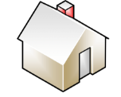

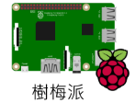
Raspberry Pi+Power Meter架構圖
網際網路
電腦
ZIGBEE Coordinator
Power Meter
ZIGBEE End Device
RS485
4
Notes:
4

Slide 5
今日需安裝的軟體:
電腦安裝,DIGI XCTU,NODE-RED,REAL VNC,WIN-SCP
MODBUS RTU
http://ebook.yourplc.net/modules/wfdownloads/singlefile.php?cid=11&lid=103
5
Notes:
5

Slide 6
準備工具:
小一字起
AC插頭電線
16AWG (或1.25mm) 電線長度60CM
24AWG(或0.5mm)電線長度100CM
電氣絕緣膠帶一捲
電烙鐵一支
焊錫20CM
電源插頭3PIN轉接2PIN.
斜口鉗
數位電錶(非必要,若有可攜帶)
6
Notes:
6

Slide 7
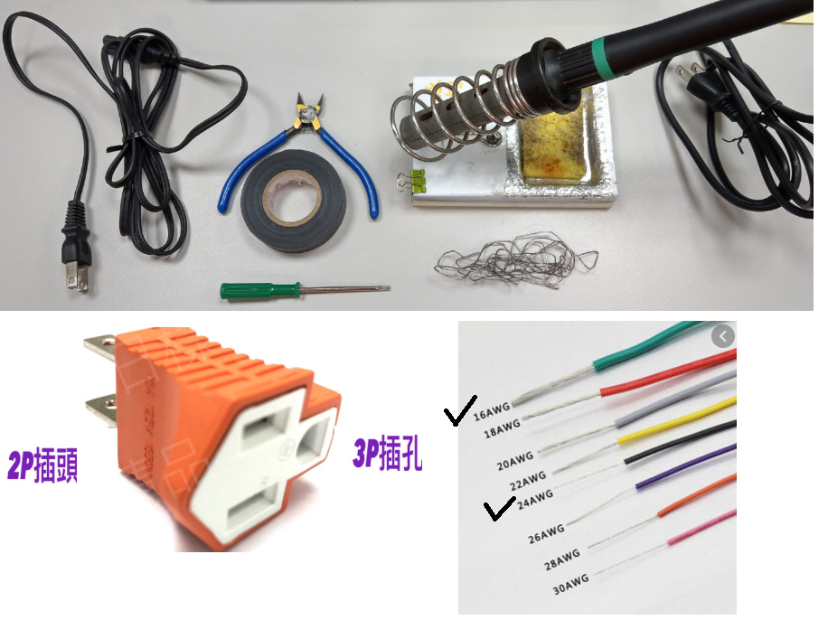
7
Notes:
7

Slide 8
Power Meter配置圖
8
Notes:
8

Slide 9
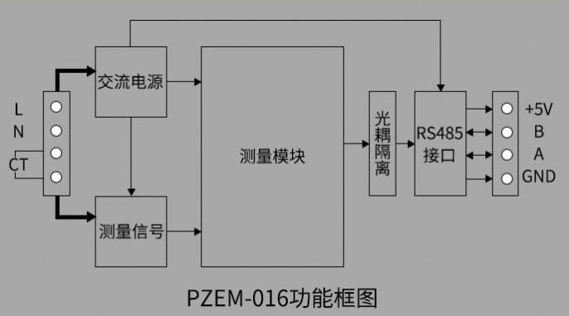
PZEM-016為AC電壓電流感測模組,RS485傳輸介面
https://www.taiwansensor.com.tw/product/%E5%96%AE%E7%9B%B8%E4%BA%A4%
E6%B5%81%E9%9B%BB%E6%99%BA%E6%85%A7%E9%9B%BB%E9%87%8F%E7%9B%A3%E6
%8E%A7%E5%99%A8-%E7%9B%A3%E6%8E%A7%E9%9B%BB%E5%A3%93%E9%9B%BB%E6
%B5%81%E9%9B%BB%E9%87%8F%E5%8A%9F/
9

Slide 10
通訊架構
Raspberry pi
Master device
RS485
MODBUS
Power Meter
Slave device
10

Slide 11
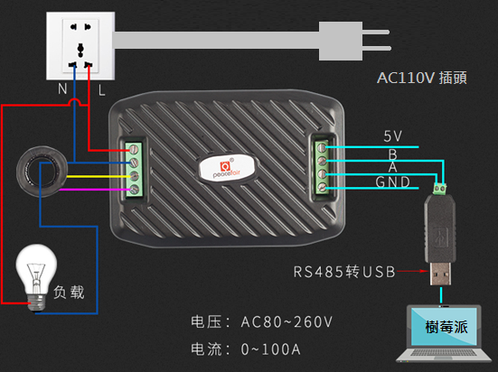
參考 https://www.youtube.com/watch?v=74gKMTsHmYY
規格書 https://images-na.ssl-images-amazon.com/images/I/81GtkIOyZaL.pdf
11
Notes:
11

Slide 12
注意:
端子的螺絲鎖緊後,用手拉一拉確認無鬆脫,以免掉落.
配線方式可參考下圖,配線花費時間大約1.5小時完成.
若無接線能力可請同學互相幫忙焊接,或請助教幫忙確認,
特別是AC 110V INPUT的部分很危險.
PZEM-16必須在AC110V插著電才會工作.
PZEM-16 5V是輸出電源,輸出電流小,不可以輸入其他電壓
12
Notes:
12

Slide 13
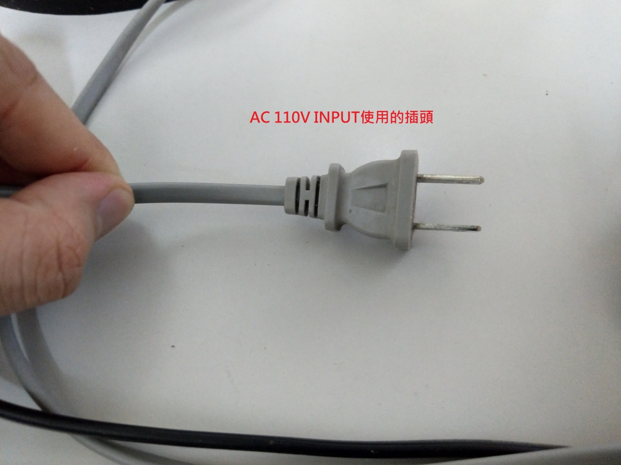
13
Notes:
13

Slide 14
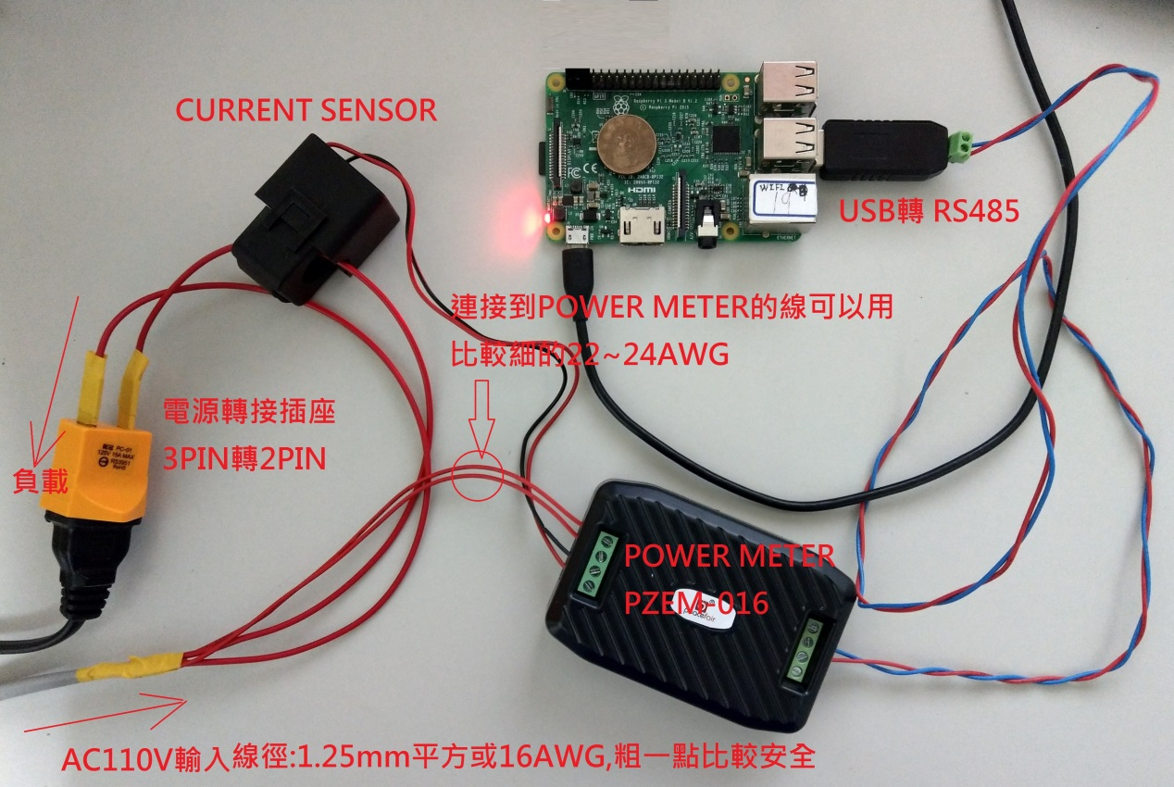
配線實照:
14
Notes:
14

Slide 15
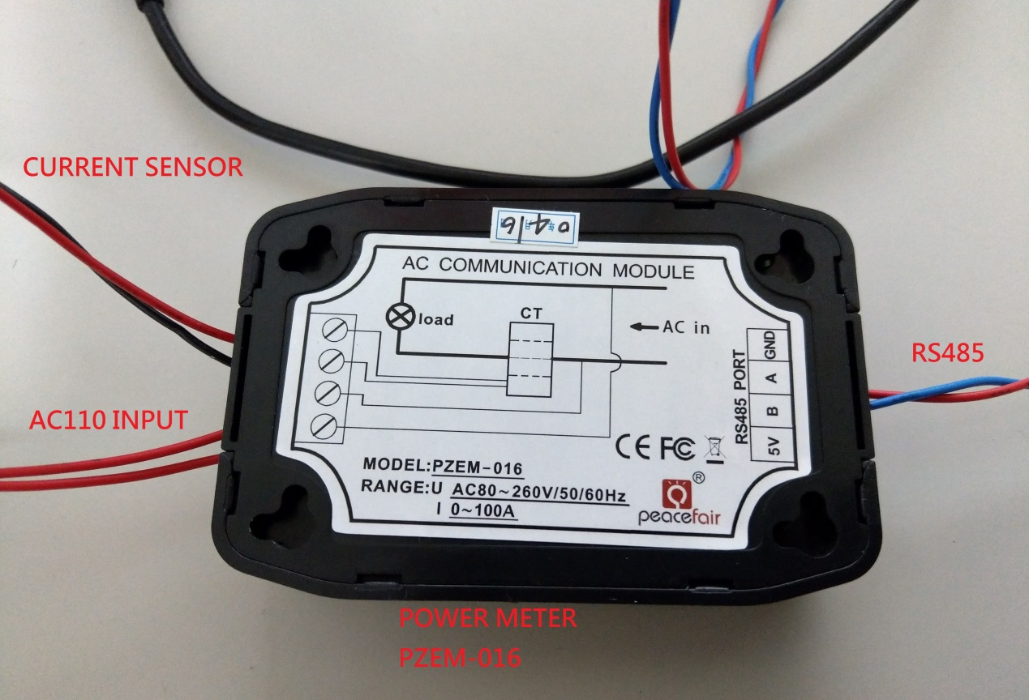
15
Notes:
15

Slide 16
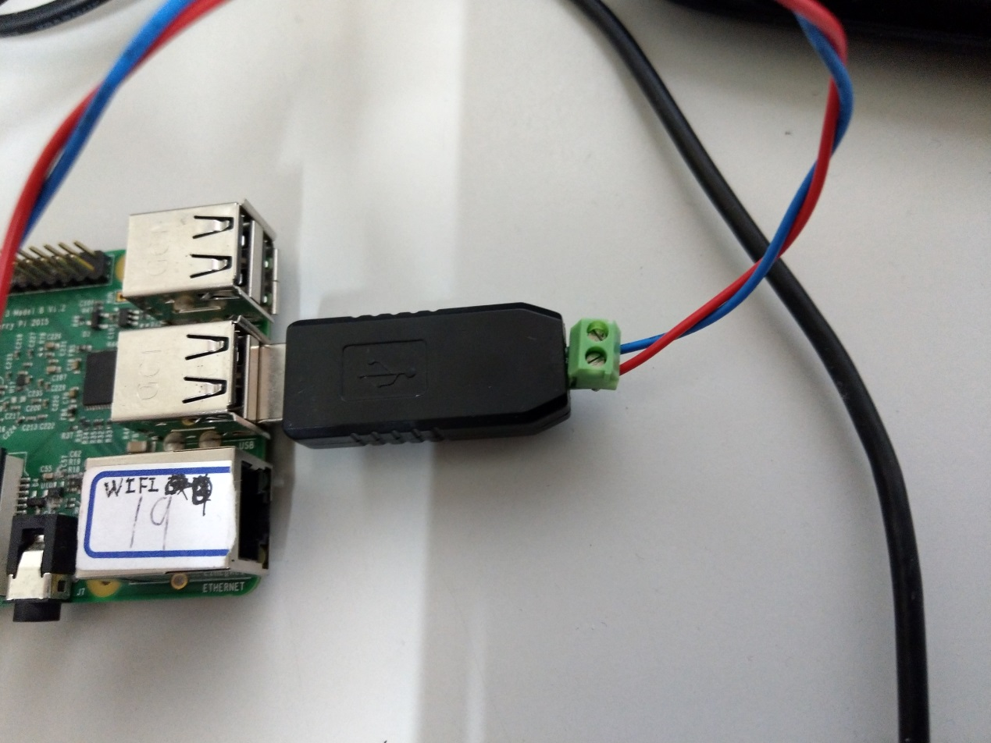
16
Notes:
16

Slide 17
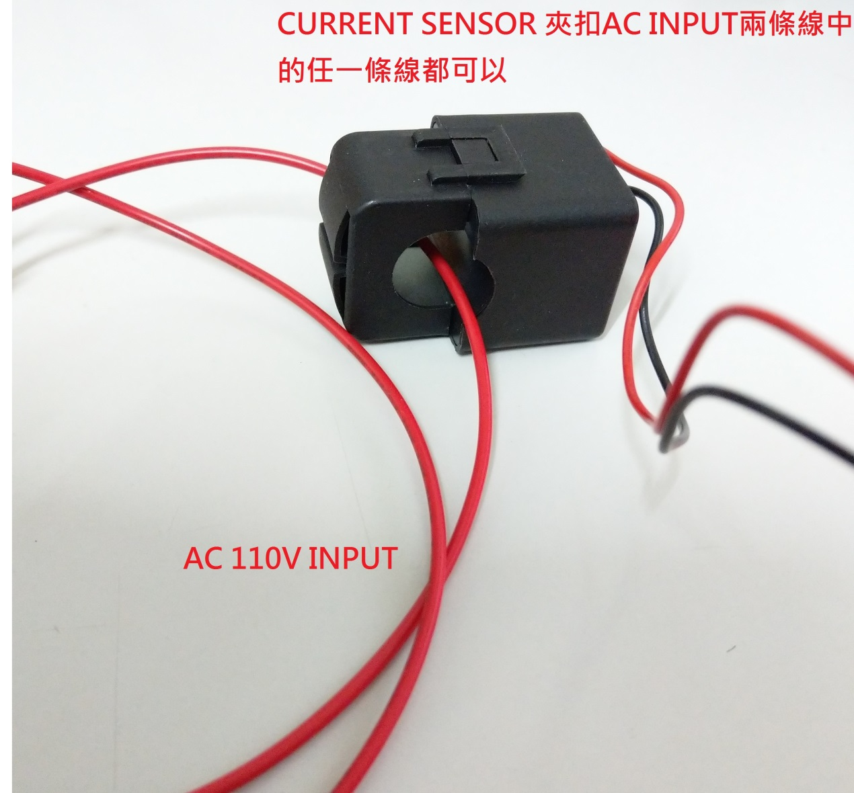
17
Notes:
17

Slide 18
Modbus工業通信協定標準
18
Notes:
18

Slide 19
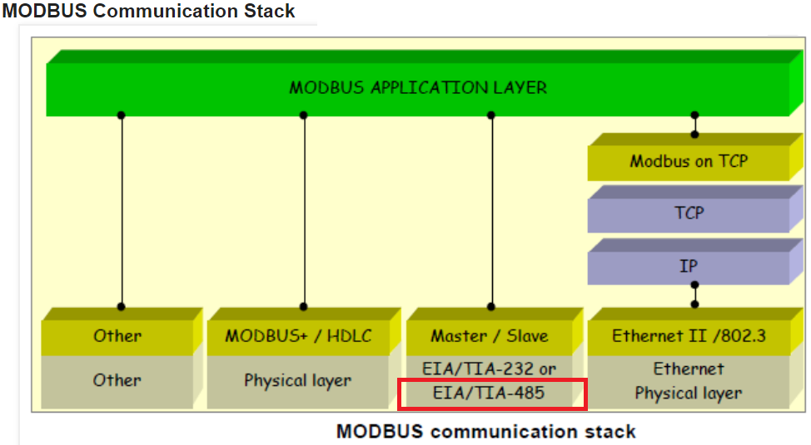
Modbus通訊可架構在不同PHY層上.
可參考https://zh.wikipedia.org/wiki/Modbus http://www.simplymodbus.ca/FAQ.htm#Modbus
本實驗的Power Meter通訊Layer 1 採用EIA-485介面
19

Slide 20
在工業控制場合使用RS232:
在工業控制、電力通訊、智能儀表等領域，通常情況下是採用Serial Port通訊的方式進行數據交換，使用RS232 Port由於工業環境比較複雜，各種電氣設備會在環境中產生較多的EMI電磁干擾，會導致訊號傳輸錯誤。
20

Slide 21
RS232在工業應用環境的缺點：
傳輸速率有限，不可以過高，一般到幾十kbps就到極限了。
使用信號線和GND與其他設備形成共地模式的通訊，這種共地模式傳輸容易產生干擾，並且抗干擾性能也比較弱。
傳輸距離有限，最多只能通訊幾十米。
連線只能兩點之間進行通訊，不能夠實現多點通訊。
21

Slide 22
工業控制場合使用RS485:
RS485解決了RS232這些問題，訊號採用差動傳輸方式，可以有效的解決共模干擾問題，最大距離可以到1200米，並且允許多個收發設備接到同一條線上。隨著工業應用設備通訊越來越多，1979年施耐德電氣制定了一個用於工業現場的總線協議Modbus協議，至今仍廣為工業設備使用。
22

Slide 23
RS485具備以下的特點：
通訊速度快，數據最高傳輸速率為10Mbps以上
傳輸速率最遠可達到1200米左右
線上允許掛多個收發器，從現有的RS485晶片來看，有可以掛32、64、128、256等不同個設備的驅動器
採用電壓差動接收，因此具有抑制共模干擾的能力
RS-485採用半雙工工作方式
23

Slide 24
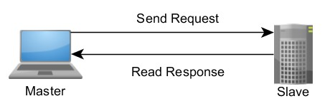
Modbus 是​一種​需求-​回應​協定，​採用​主​從​架構​實作​而​成
24

Slide 25
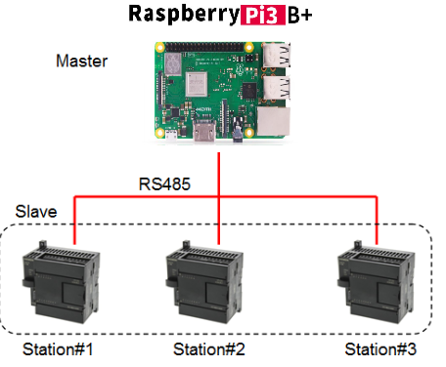
1 Master device to multi-slave device.
Power Meter
Temerature Sensor
Humidity Sensor
25

Slide 26
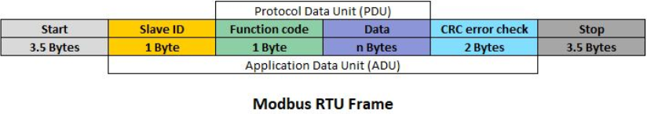
Modbus Frame Format
26

Slide 27
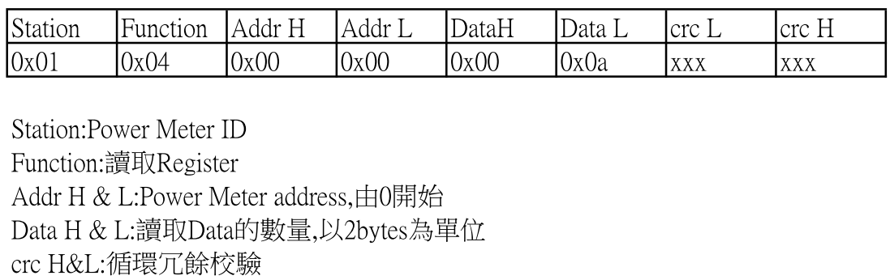
Modbus Read Input Registers指令
參考 http://www.simplymodbus.ca/FC04.htm
27

Slide 28
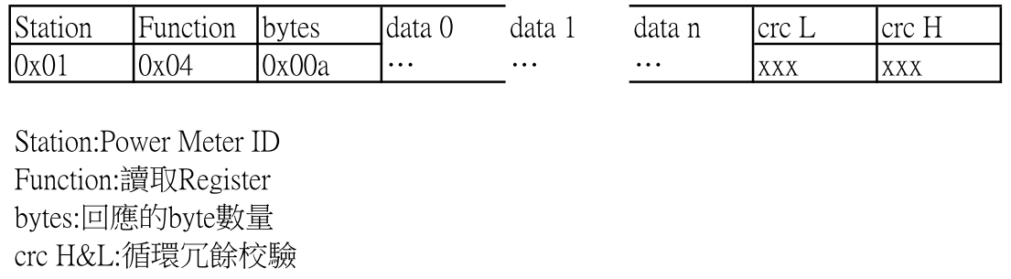
Power Meter回應的封包
28

Slide 29
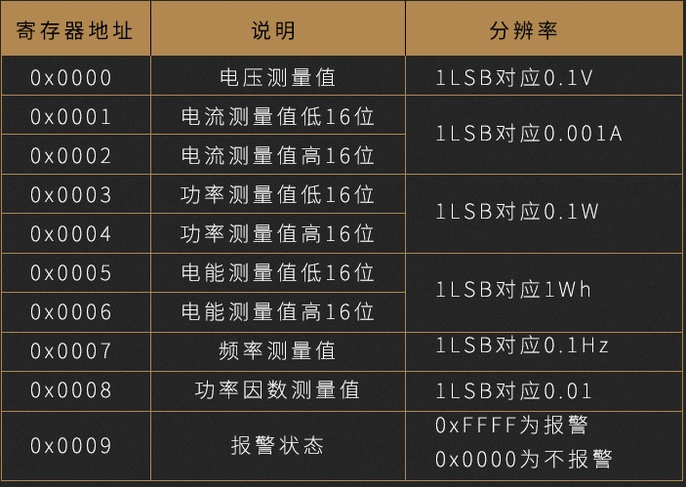
Power Meter Modbus Spec
29

Slide 30
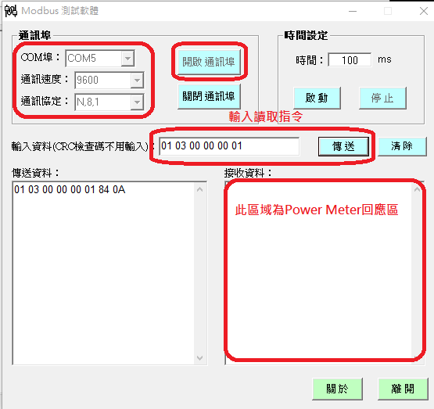
Modbus RTU測試軟體功能
30

Slide 31
Modbus RTU測試軟體功能
觀察Power Meter RS485收發封包是否正常
手動輸入測試指令,例如Power Meter讀取電壓,確認指令是否正確
測試設備傳輸速率,9600bps至115200bps
測試最大傳輸距離,及是否受到干擾
31

Slide 32
通訊架構
使用Modbus RTU查看RS485通訊內容
Raspberry pi
Computer
RS485
MODBUS
MODBUS
RS485
Power Meter
AB兩條通訊線並接
32

Slide 33
NODE RED程式設計
33
Notes:
33

Slide 34
第一部分code:
[{"id":"c83a3d90.1abd6","type":"inject","z":"b8a1d0c1.affd3","name":"","topic":"","payload":"","payloadType":"date","repeat":"","crontab":"","once":true,"x":130,"y":100,"wires":[["44d2d7.8f12ad28"]]},{"id":"44d2d7.8f12ad28","type":"function","z":"b8a1d0c1.affd3","name":"first step initial all global variable to 0","func":"//global variable define\nvar power_meter_data=\n{\n voltage:0,\n ampere:0,\n watt:0,\n PF:0,\n id:\"power_meter_data\",\n rs485_online:0\n};\nglobal.set(\"power_meter_data\",power_meter_data);\nreturn power_meter_data;","outputs":1,"noerr":0,"x":400,"y":100,"wires":[[]]},{"id":"465f0c3c.060824","type":"comment","z":"b8a1d0c1.affd3","name":"開機初始值","info":"","x":120,"y":40,"wires":[]}]

Slide 35
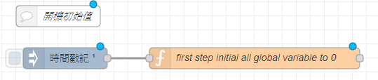
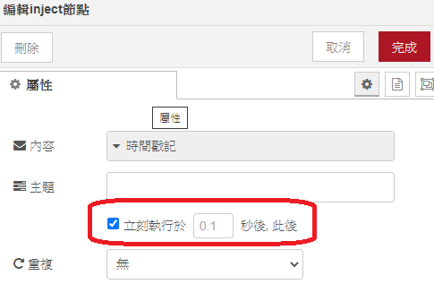
Initial Value Settings
35
Notes:
35

Slide 36
在Function node輸入以下
//global variable define
var power_meter_data=
{
voltage:0,
ampere:0,
watt:0,
PF:0,
id:"power_meter_data",
rs485_online:0
};
global.set("power_meter_data",power_meter_data);
return power_meter_data;
36

Slide 37
第二部分code:
[{"id":"9a4b18a4.d0dc68","type":"inject","z":"b8a1d0c1.affd3","name":"","topic":"","payload":"","payloadType":"date","repeat":"1","crontab":"","once":false,"onceDelay":"","x":130,"y":440,"wires":[["e8697ad2.7c3bc8"]]},{"id":"6751744b.1719bc","type":"debug","z":"b8a1d0c1.affd3","name":"build object msg","active":true,"tosidebar":true,"console":false,"tostatus":false,"complete":"true","targetType":"full","x":600,"y":440,"wires":[]},{"id":"e8697ad2.7c3bc8","type":"function","z":"b8a1d0c1.affd3","name":"build object","func":"var power_meter_data=global.get(\"power_meter_data\");\n//if rs485 online then save data,else fill 0 to data\nif(power_meter_data.rs485_online===1)\n{\n msg.payload = \n {\n \"voltage\":power_meter_data.voltage,\n \"ampere\":power_meter_data.ampere,\n \"watt\":power_meter_data.watt,\n \"powerfactor\":power_meter_data.PF,\n \"rs485_online\":power_meter_data.rs485_online\n };\n}\nelse\n{\n msg.payload = \n {\n \"voltage\":0,\n \"ampere\":0,\n \"watt\":0,\n \"powerfactor\":0,\n \"rs485_online\":power_meter_data.rs485_online\n };\n}\npower_meter_data.rs485_online=0; //clear for next rs485 online test\nglobal.set(\"power_meter_data\",power_meter_data);\n\nreturn msg;","outputs":1,"noerr":0,"x":310,"y":440,"wires":[["cd6248af.0e3da8","6751744b.1719bc","2afdf849.3bac08"]]},{"id":"e63e3e0b.1912a","type":"ui_text","z":"b8a1d0c1.affd3","group":"99df8896.a3e2f8","order":1,"width":0,"height":0,"name":"","label":"voltage","format":"{{msg.payload}} V","layout":"row-spread","x":620,"y":620,"wires":[]},{"id":"a1179e9d.6f7b4","type":"ui_text","z":"b8a1d0c1.affd3","group":"99df8896.a3e2f8","order":3,"width":0,"height":0,"name":"","label":"ampere","format":"{{msg.payload}} A","layout":"row-spread","x":600,"y":700,"wires":[]},{"id":"d6539b23.1ddc78","type":"ui_text","z":"b8a1d0c1.affd3","group":"99df8896.a3e2f8","order":5,"width":0,"height":0,"name":"","label":"watt","format":"{{msg.payload}} W","layout":"row-spread","x":590,"y":780,"wires":[]},{"id":"6394562a.3d3ba8","type":"ui_text","z":"b8a1d0c1.affd3","group":"99df8896.a3e2f8","order":7,"width":0,"height":0,"name":"","label":"Power Factor","format":"{{msg.payload}} %","layout":"row-spread","x":590,"y":880,"wires":[]},{"id":"69b2fbe3.ffaad4","type":"ui_chart","z":"b8a1d0c1.affd3","name":"","group":"99df8896.a3e2f8","order":2,"width":0,"height":0,"label":"voltage_trend","chartType":"line","legend":"false","xformat":"HH:mm:ss","interpolate":"linear","nodata":"","dot":false,"ymin":"0","ymax":"130","removeOlder":"3","removeOlderPoints":"","removeOlderUnit":"60","cutout":0,"useOneColor":false,"colors":["#1f77b4","#aec7e8","#ff7f0e","#2ca02c","#98df8a","#d62728","#ff9896","#9467bd","#c5b0d5"],"useOldStyle":false,"outputs":1,"x":650,"y":580,"wires":[[]]},{"id":"10d64ad.f5cd1b5","type":"ui_chart","z":"b8a1d0c1.affd3","name":"","group":"99df8896.a3e2f8","order":4,"width":0,"height":0,"label":"ampere_trend","chartType":"line","legend":"false","xformat":"HH:mm:ss","interpolate":"linear","nodata":"","dot":false,"ymin":"0","ymax":"","removeOlder":"3","removeOlderPoints":"","removeOlderUnit":"60","cutout":0,"useOneColor":false,"colors":["#1f77b4","#aec7e8","#ff7f0e","#2ca02c","#98df8a","#d62728","#ff9896","#9467bd","#c5b0d5"],"useOldStyle":false,"outputs":1,"x":620,"y":660,"wires":[[]]},{"id":"7fca402f.6c0c3","type":"ui_chart","z":"b8a1d0c1.affd3","name":"","group":"99df8896.a3e2f8","order":6,"width":0,"height":0,"label":"watt_trend","chartType":"line","legend":"false","xformat":"HH:mm:ss","interpolate":"linear","nodata":"","dot":false,"ymin":"0","ymax":"","removeOlder":"3","removeOlderPoints":"","removeOlderUnit":"60","cutout":0,"useOneColor":false,"colors":["#1f77b4","#aec7e8","#ff7f0e","#2ca02c","#98df8a","#d62728","#ff9896","#9467bd","#c5b0d5"],"useOldStyle":false,"outputs":1,"x":610,"y":740,"wires":[[]]},{"id":"7104ea20.16ded4","type":"ui_chart","z":"b8a1d0c1.affd3","name":"","group":"99df8896.a3e2f8","order":8,"width":0,"height":0,"label":"Power Factor trend","chartType":"horizontalBar","legend":"false","xformat":"HH:mm:ss","interpolate":"linear","nodata":"","dot":false,"ymin":"0","ymax":"1","removeOlder":"3","removeOlderPoints":"","removeOlderUnit":"60","cutout":0,"useOneColor":false,"colors":["#1f77b4","#aec7e8","#ff7f0e","#2ca02c","#98df8a","#d62728","#ff9896","#9467bd","#c5b0d5"],"useOldStyle":false,"outputs":1,"x":610,"y":820,"wires":[[]]},{"id":"2afdf849.3bac08","type":"function","z":"b8a1d0c1.affd3","name":"dashboard object","func":"var dashboard_voltage={payload:msg.payload.voltage};\nvar dashboard_ampere={payload:msg.payload.ampere};\nvar dashboard_watt={payload:msg.payload.watt};\nvar dashboard_powerfactor={payload:msg.payload.powerfactor};\nvar dashboard_rs485_online={payload:msg.payload.rs485_online};\n\nreturn [dashboard_voltage,dashboard_ampere,dashboard_watt,dashboard_powerfactor,dashboard_rs485_online]","outputs":5,"noerr":0,"x":370,"y":600,"wires":[["e63e3e0b.1912a","69b2fbe3.ffaad4"],["10d64ad.f5cd1b5","a1179e9d.6f7b4"],["7fca402f.6c0c3","d6539b23.1ddc78"],["7104ea20.16ded4","6394562a.3d3ba8"],[]]},{"id":"82e3d28b.99862","type":"comment","z":"b8a1d0c1.affd3","name":"定期更新儀錶板&電源數據存檔","info":"","x":170,"y":380,"wires":[]},{"id":"e8c539d6.400158","type":"comment","z":"b8a1d0c1.affd3","name":"儀錶板顯示","info":"","x":360,"y":520,"wires":[]},{"id":"99df8896.a3e2f8","type":"ui_group","z":"","name":"meter","tab":"acf230be.ed314","order":1,"disp":true,"width":"6","collapse":false},{"id":"acf230be.ed314","type":"ui_tab","z":"","name":"home","icon":"dashboard","order":1}]

Slide 38
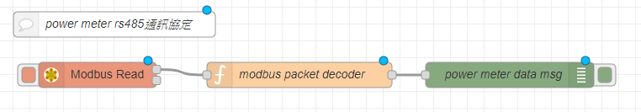
Modbus Decode
38
Notes:
38

Slide 39
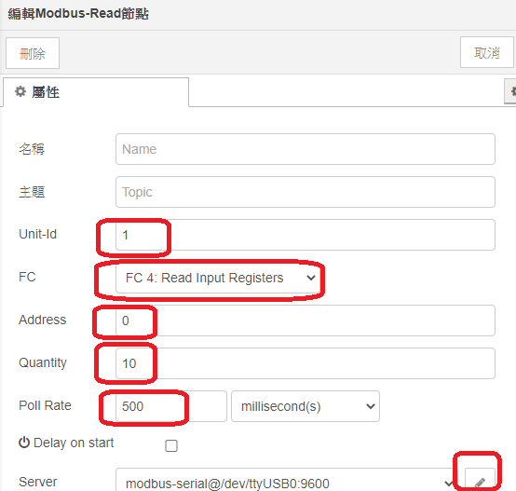
Modbus Read 編輯
39
Notes:
39

Slide 40
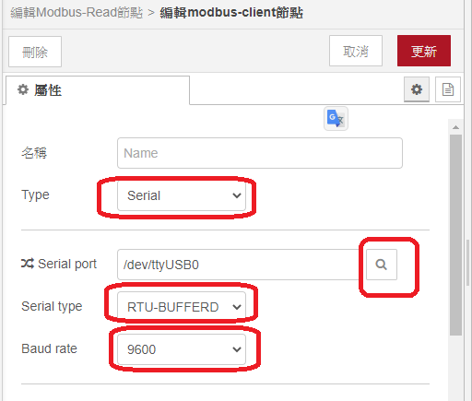
Modbus Read 編輯
40
Notes:
40

Slide 41
在Function node輸入以下
//packet decoder
msg.voltage=msg.payload[0]/10;
msg.ampere=(msg.payload[2]*65535+msg.payload[1])/1000;
msg.watt=(msg.payload[4]*65535+msg.payload[3])/10;
msg.Wh=(msg.payload[6]*65535+msg.payload[5])/1000;
msg.freq=msg.payload[7]/10;
msg.PF=msg.payload[8]/100;
msg.alarm=msg.payload[9];
//save data to global variables
var power_meter_data=global.get("power_meter_data");
power_meter_data.voltage=msg.voltage;
power_meter_data.ampere=msg.ampere;
power_meter_data.watt=msg.watt;
power_meter_data.PF=msg.PF;
power_meter_data.rs485_online=1;
global.set("power_meter_data",power_meter_data);
return power_meter_data
41

Slide 42
第三部分code:
[{"id":"9a4b18a4.d0dc68","type":"inject","z":"b8a1d0c1.affd3","name":"","topic":"","payload":"","payloadType":"date","repeat":"1","crontab":"","once":false,"onceDelay":"","x":130,"y":440,"wires":[["e8697ad2.7c3bc8"]]},{"id":"6751744b.1719bc","type":"debug","z":"b8a1d0c1.affd3","name":"build object msg","active":true,"tosidebar":true,"console":false,"tostatus":false,"complete":"true","targetType":"full","x":600,"y":440,"wires":[]},{"id":"e8697ad2.7c3bc8","type":"function","z":"b8a1d0c1.affd3","name":"build object","func":"var power_meter_data=global.get(\"power_meter_data\");\n//if rs485 online then save data,else fill 0 to data\nif(power_meter_data.rs485_online===1)\n{\n msg.payload = \n {\n \"voltage\":power_meter_data.voltage,\n \"ampere\":power_meter_data.ampere,\n \"watt\":power_meter_data.watt,\n \"powerfactor\":power_meter_data.PF,\n \"rs485_online\":power_meter_data.rs485_online\n };\n}\nelse\n{\n msg.payload = \n {\n \"voltage\":0,\n \"ampere\":0,\n \"watt\":0,\n \"powerfactor\":0,\n \"rs485_online\":power_meter_data.rs485_online\n };\n}\npower_meter_data.rs485_online=0; //clear for next rs485 online test\nglobal.set(\"power_meter_data\",power_meter_data);\n\nreturn msg;","outputs":1,"noerr":0,"x":310,"y":440,"wires":[["cd6248af.0e3da8","6751744b.1719bc","2afdf849.3bac08"]]},{"id":"e63e3e0b.1912a","type":"ui_text","z":"b8a1d0c1.affd3","group":"99df8896.a3e2f8","order":1,"width":0,"height":0,"name":"","label":"voltage","format":"{{msg.payload}} V","layout":"row-spread","x":620,"y":620,"wires":[]},{"id":"a1179e9d.6f7b4","type":"ui_text","z":"b8a1d0c1.affd3","group":"99df8896.a3e2f8","order":3,"width":0,"height":0,"name":"","label":"ampere","format":"{{msg.payload}} A","layout":"row-spread","x":600,"y":700,"wires":[]},{"id":"d6539b23.1ddc78","type":"ui_text","z":"b8a1d0c1.affd3","group":"99df8896.a3e2f8","order":5,"width":0,"height":0,"name":"","label":"watt","format":"{{msg.payload}} W","layout":"row-spread","x":590,"y":780,"wires":[]},{"id":"6394562a.3d3ba8","type":"ui_text","z":"b8a1d0c1.affd3","group":"99df8896.a3e2f8","order":7,"width":0,"height":0,"name":"","label":"Power Factor","format":"{{msg.payload}} %","layout":"row-spread","x":590,"y":880,"wires":[]},{"id":"69b2fbe3.ffaad4","type":"ui_chart","z":"b8a1d0c1.affd3","name":"","group":"99df8896.a3e2f8","order":2,"width":0,"height":0,"label":"voltage_trend","chartType":"line","legend":"false","xformat":"HH:mm:ss","interpolate":"linear","nodata":"","dot":false,"ymin":"0","ymax":"130","removeOlder":"3","removeOlderPoints":"","removeOlderUnit":"60","cutout":0,"useOneColor":false,"colors":["#1f77b4","#aec7e8","#ff7f0e","#2ca02c","#98df8a","#d62728","#ff9896","#9467bd","#c5b0d5"],"useOldStyle":false,"outputs":1,"x":650,"y":580,"wires":[[]]},{"id":"10d64ad.f5cd1b5","type":"ui_chart","z":"b8a1d0c1.affd3","name":"","group":"99df8896.a3e2f8","order":4,"width":0,"height":0,"label":"ampere_trend","chartType":"line","legend":"false","xformat":"HH:mm:ss","interpolate":"linear","nodata":"","dot":false,"ymin":"0","ymax":"","removeOlder":"3","removeOlderPoints":"","removeOlderUnit":"60","cutout":0,"useOneColor":false,"colors":["#1f77b4","#aec7e8","#ff7f0e","#2ca02c","#98df8a","#d62728","#ff9896","#9467bd","#c5b0d5"],"useOldStyle":false,"outputs":1,"x":620,"y":660,"wires":[[]]},{"id":"7fca402f.6c0c3","type":"ui_chart","z":"b8a1d0c1.affd3","name":"","group":"99df8896.a3e2f8","order":6,"width":0,"height":0,"label":"watt_trend","chartType":"line","legend":"false","xformat":"HH:mm:ss","interpolate":"linear","nodata":"","dot":false,"ymin":"0","ymax":"","removeOlder":"3","removeOlderPoints":"","removeOlderUnit":"60","cutout":0,"useOneColor":false,"colors":["#1f77b4","#aec7e8","#ff7f0e","#2ca02c","#98df8a","#d62728","#ff9896","#9467bd","#c5b0d5"],"useOldStyle":false,"outputs":1,"x":610,"y":740,"wires":[[]]},{"id":"7104ea20.16ded4","type":"ui_chart","z":"b8a1d0c1.affd3","name":"","group":"99df8896.a3e2f8","order":8,"width":0,"height":0,"label":"Power Factor trend","chartType":"horizontalBar","legend":"false","xformat":"HH:mm:ss","interpolate":"linear","nodata":"","dot":false,"ymin":"0","ymax":"1","removeOlder":"3","removeOlderPoints":"","removeOlderUnit":"60","cutout":0,"useOneColor":false,"colors":["#1f77b4","#aec7e8","#ff7f0e","#2ca02c","#98df8a","#d62728","#ff9896","#9467bd","#c5b0d5"],"useOldStyle":false,"outputs":1,"x":610,"y":820,"wires":[[]]},{"id":"2afdf849.3bac08","type":"function","z":"b8a1d0c1.affd3","name":"dashboard object","func":"var dashboard_voltage={payload:msg.payload.voltage};\nvar dashboard_ampere={payload:msg.payload.ampere};\nvar dashboard_watt={payload:msg.payload.watt};\nvar dashboard_powerfactor={payload:msg.payload.powerfactor};\nvar dashboard_rs485_online={payload:msg.payload.rs485_online};\n\nreturn [dashboard_voltage,dashboard_ampere,dashboard_watt,dashboard_powerfactor,dashboard_rs485_online]","outputs":5,"noerr":0,"x":370,"y":600,"wires":[["e63e3e0b.1912a","69b2fbe3.ffaad4"],["10d64ad.f5cd1b5","a1179e9d.6f7b4"],["7fca402f.6c0c3","d6539b23.1ddc78"],["7104ea20.16ded4","6394562a.3d3ba8"],[]]},{"id":"82e3d28b.99862","type":"comment","z":"b8a1d0c1.affd3","name":"定期更新儀錶板&電源數據存檔","info":"","x":170,"y":380,"wires":[]},{"id":"e8c539d6.400158","type":"comment","z":"b8a1d0c1.affd3","name":"儀錶板顯示","info":"","x":360,"y":520,"wires":[]},{"id":"99df8896.a3e2f8","type":"ui_group","z":"","name":"meter","tab":"acf230be.ed314","order":1,"disp":true,"width":"6","collapse":false},{"id":"acf230be.ed314","type":"ui_tab","z":"","name":"home","icon":"dashboard","order":1}]

Slide 43
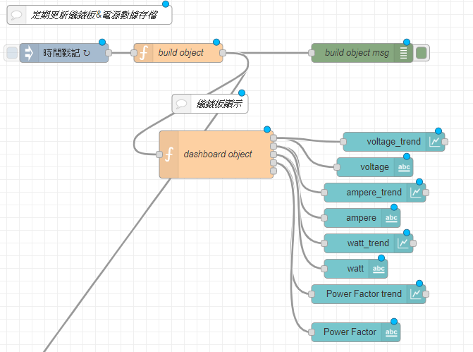
Dashboard
43
Notes:
43

Slide 44
在Function node (build object)輸入以下
var power_meter_data=global.get("power_meter_data");
//if rs485 online then save data,else fill 0 to data
if(power_meter_data.rs485_online===1){
msg.payload =
{
"voltage":power_meter_data.voltage,
"ampere":power_meter_data.ampere,
"watt":power_meter_data.watt,
"powerfactor":power_meter_data.PF,
"rs485_online":power_meter_data.rs485_online
};
}
else{
msg.payload =
{
"voltage":0,
"ampere":0,
"watt":0,
"powerfactor":0,
"rs485_online":power_meter_data.rs485_online
};
}
power_meter_data.rs485_online=0;
//clear for next rs485 online test
global.set("power_meter_data",power_meter_data);
return msg;
44

Slide 45
在Function node (dashboard object)輸入以下
var dashboard_voltage={payload:msg.payload.voltage};
var dashboard_ampere={payload:msg.payload.ampere};
var dashboard_watt={payload:msg.payload.watt};
var dashboard_powerfactor={payload:msg.payload.powerfactor};
var dashboard_rs485_online={payload:msg.payload.rs485_online};
return [dashboard_voltage,dashboard_ampere,
dashboard_watt,dashboard_powerfactor,dashboard_rs485_online]
45

Slide 46
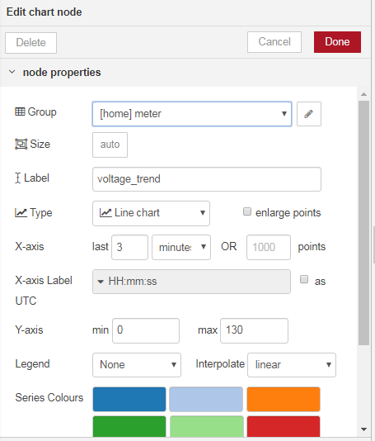
chart顯示的區域
圖標題
設為線圖
時間範圍
電壓(電流)範圍
46

Slide 47
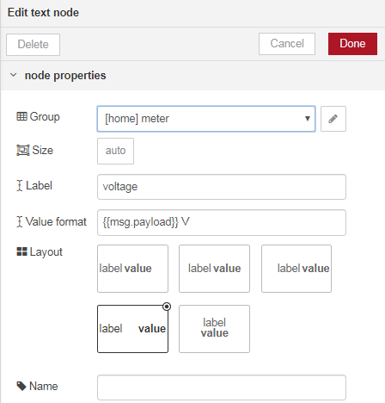
Label顯示”voltage”
電壓數值,及單位
47

Slide 48
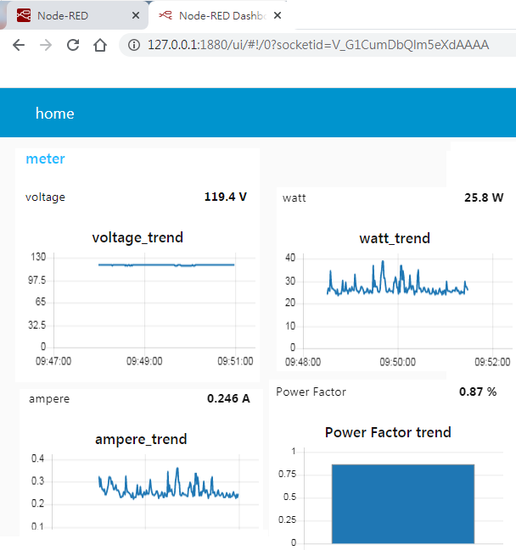
48

Slide 49
第四部分code:
[{"id":"cd6248af.0e3da8","type":"function","z":"b8a1d0c1.affd3","name":"add data time stamp","func":"var now = new Date(); \nvar year = now.getFullYear();\nvar month = now.getMonth()+1; \nvar day = now.getDate();\nvar hour = now.getHours();\nvar minute = now.getMinutes();\nvar second = now.getSeconds(); \nif(month.toString().length == 1) \n{\n month = '0'+month;\n}\nif(day.toString().length == 1) \n{\n day = '0'+day;\n} \nif(hour.toString().length == 1) \n{\n hour = '0'+hour;\n}\nif(minute.toString().length == 1) \n{\n minute = '0'+minute;\n}\nif(second.toString().length == 1) \n{\n second = '0'+second;\n} \n\n//csv file path\nmsg.filename='/home/pi/Desktop/PowerMeter/PowerMeter_'+year+month+day+ '.csv';\nmsg.payload.timestamp =hour+':'+minute+':'+second;\n\nif((hour=='00')&&(minute=='00')&&((second<='00'))) //cross day\n{\n return [null,msg]; //2th output csv title field\n}\nelse //other time\n{\n return [msg,null]; //1st output csv data field\n}","outputs":"2","noerr":0,"x":180,"y":1020,"wires":[["be4fc5d3.0f2d28"],["96bea81d.ff1bf8"]]},{"id":"be4fc5d3.0f2d28","type":"csv","z":"b8a1d0c1.affd3","name":"紀錄每秒數值","sep":",","hdrin":true,"hdrout":false,"multi":"one","ret":"\\n","temp":"timestamp,voltage,ampere,watt,powerfactor,rs485_online","skip":0,"strings":true,"x":460,"y":1000,"wires":[["263bccab.06b504","d4d0c8c8.d71768"]]},{"id":"263bccab.06b504","type":"file","z":"b8a1d0c1.affd3","name":"file saved at tc_data","filename":"","appendNewline":false,"createDir":true,"overwriteFile":"false","x":820,"y":1000,"wires":[[]]},{"id":"96bea81d.ff1bf8","type":"csv","z":"b8a1d0c1.affd3","name":"跨零時填標題","sep":",","hdrin":false,"hdrout":true,"multi":"one","ret":"\\n","temp":"timestamp,voltage,ampere,watt,powerfactor,rs485_online","skip":0,"strings":true,"x":460,"y":1040,"wires":[["263bccab.06b504","d4d0c8c8.d71768"]]},{"id":"d4d0c8c8.d71768","type":"debug","z":"b8a1d0c1.affd3","d":true,"name":"","active":true,"tosidebar":true,"console":false,"tostatus":false,"complete":"payload","targetType":"msg","x":810,"y":1080,"wires":[]},{"id":"99cd33e8.3e0df","type":"comment","z":"b8a1d0c1.affd3","name":"存檔","info":"","x":170,"y":960,"wires":[]}]

Slide 50
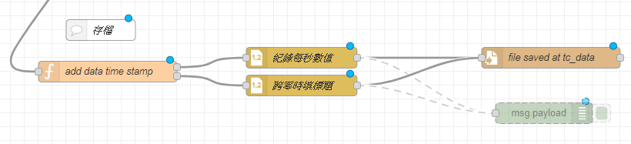

Slide 51
在Function node (dashboard object)輸入以下
var now = new Date();
var year = now.getFullYear();
var month = now.getMonth()+1;
var day = now.getDate();
var hour = now.getHours();
var minute = now.getMinutes();
var second = now.getSeconds();
if(month.toString().length == 1)
{ month = '0'+month;}
if(day.toString().length == 1)
{ day = '0'+day;}
if(hour.toString().length == 1)
{ hour = '0'+hour;}
if(minute.toString().length == 1)
{ minute = '0'+minute;}
if(second.toString().length == 1)
{ second = '0'+second;}
//csv file path
msg.filename='/home/pi/Desktop/PowerMeter/PowerMeter_'+year+month+day+ '.csv';
msg.payload.timestamp =hour+':'+minute+':'+second;
if((hour=='00')&&(minute=='00')&&((second<='00')))
//cross day
{ return [null,msg];
//2th output csv title field
}else //other time{ return [msg,null]; //1st output csv data field}
存檔路徑,linux檔案目錄使用/ windows使用\
51

Slide 52
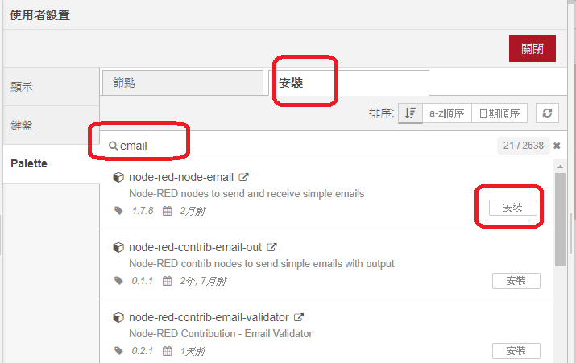
Email node:
設定超過用電量,發送email通知使用者
可傳送任何形態的參數
52

Slide 53
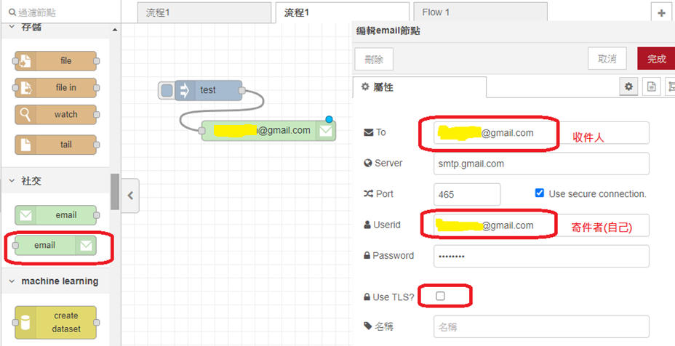
53

Slide 54
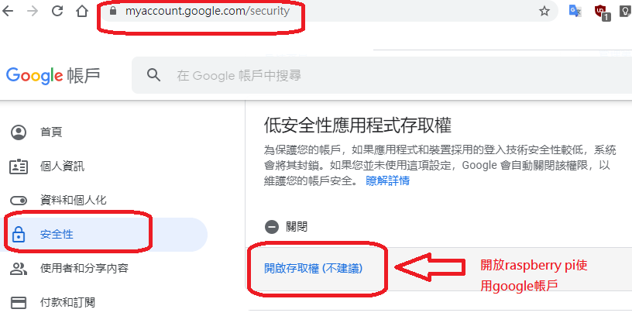
Gmail使用者須做以下設定
54

Slide 55
習題
55
Notes:
55

Slide 56
Internet
習題1:
在家庭環境下,
使用網路基礎設施
傳遞訊息
MQTT
MQTT
Raspberry pi
Desktop Computer
RS485
MODBUS
用電腦NODE RED的
DASHBOARD顯示用電數據
Power Meter
56

Slide 57
習題2:
在無網路環境下,
使用ZigBee無線電
傳遞訊息
ZigBee
ZigBee
Raspberry pi
NoteBook
Computer
RS485
MODBUS
用電腦NODE RED的
DASHBOARD顯示用電數據
Power Meter
57

Slide 58
Reference
58
Notes:
58

Slide 59
Node js語法英文參考(推薦)
https://www.w3schools.com/js/default.asp
Node js語法中文參考
https://dca.gitbooks.io/nodejs-tw-wiki-book/content/index.html
Node-red官方GitHub
https://github.com/node-red
59

Slide 60
Thank you ☺
60
Notes:
60

